Slide 1
NE 763: Advanced Reactor Materials
Fall 2026
Dr. Benjamin Beeler

Slide 2
Last Time
Pu enriched regions
  Pu redistributes through the pore migration process, enriching near the central pore
  Pu agglomerates can also occur due to poor mixing
Oxygen redistributes radially, enriching near fuel/cladding interface
Fission product phases differ in MOX, located and morphology vary based on restructuring and spatial oxygen distribution
JOG: CsMoO4 type of FP phase forming at fuel/cladding interface
  increases kth, mechanical buffer, leads to FCCI
Sodium coolant
  high kth, large margin to boil, high Cp, etc.
  solubility of cladding constituents varies on temperature and impurities

Slide 3
Sodium Corrosion
The solubility of each of the primary components of stainless steel in sodium at 550 C is less than a few parts per million
This means that the nominal compatibility of the steels with sodium is excellent
In the isothermal sodium condition, the corrosion of the steels stops when the dissolved elements reach saturation concentration at the temperature of sodium
Under non-isothermal conditions, the corrosion behavior is called thermal gradient mass transfer
In the cooling system, the elements in the materials in the high-temperature section dissolve as a result of the temperature dependency of the solubility of the elements in sodium, and the dissolved elements are deposited on the steel surface in the low-temperature section by the same mechanism

Slide 4
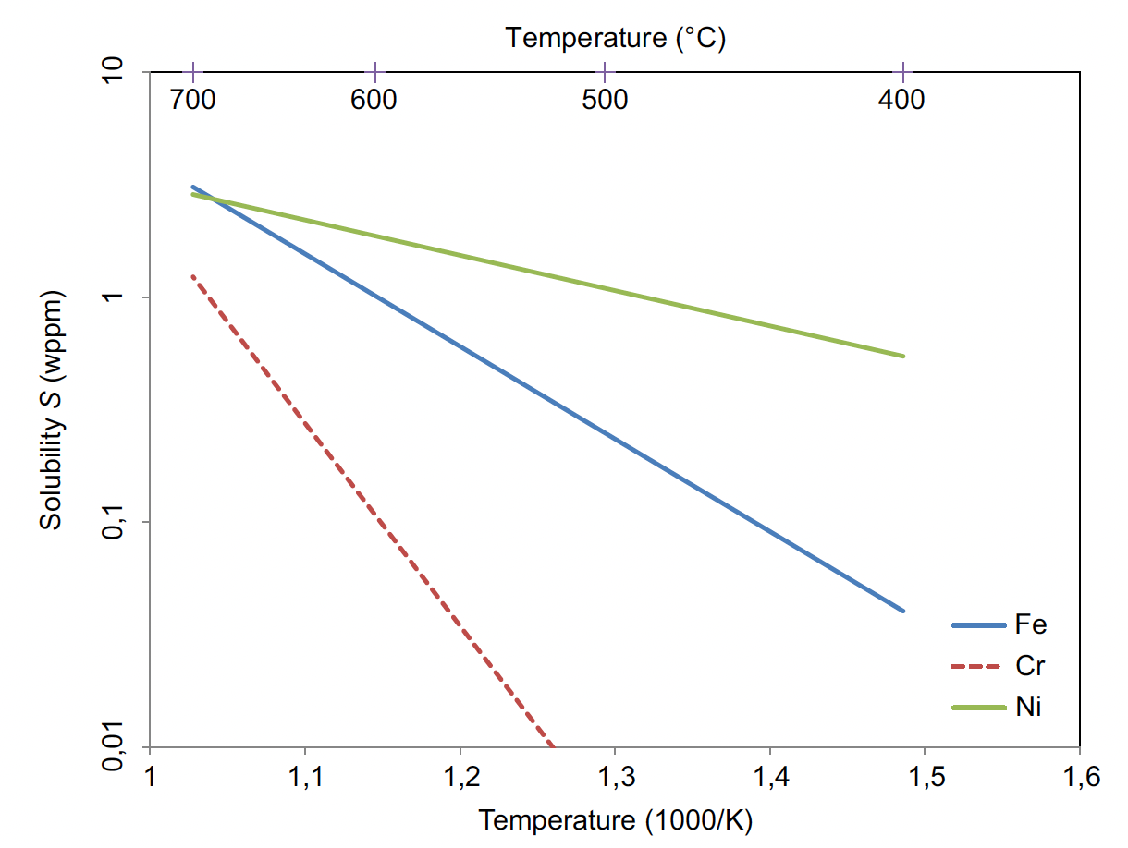
Thermal gradient mass transfer
Coolant heated in the core; high solubility for elements in the coolant; elements leave structural materials, go into coolant
Heat removed from coolant via IHX; lower T means lower solubility; elements plate out on piping surfaces; coolant now has lower concentration of corrosion species

Slide 5
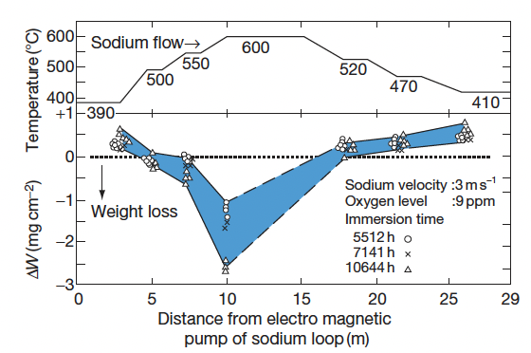
Sodium Corrosion
The results of thermal gradient mass transfer using a sodium loop made of 316SS
The weight loss caused by the dissolution of the elements in the steel is in the high-temperature section, and the weight gain caused by the deposit of the dissolved elements in sodium is observed in the low-temperature section

Slide 6
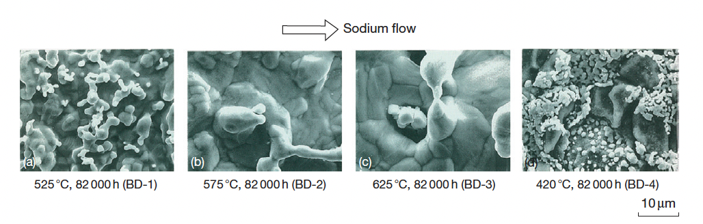
Sodium Corrosion
Dissolution of the elements in the material is observed in the high-temperature section, and precipitation is observed in the low-temperature section

Slide 7
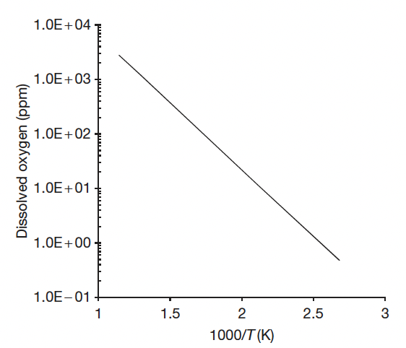
Impurity Sodium Corrosion
Type II-Corrosion Produced Through Chemical Reaction with the Impurities in Sodium
The control of impurities in sodium can be achieved by using techniques to deposit/collect the dissolved impurities in sodium
Impurities such as oxygen, carbon and nitrogen in sodium can have a strong effect on the corrosion rate of a material
Sodium is the reducing agent, and its affinity to oxygen is very strong
The solubility of oxygen in sodium is significantly higher than in water

Slide 8
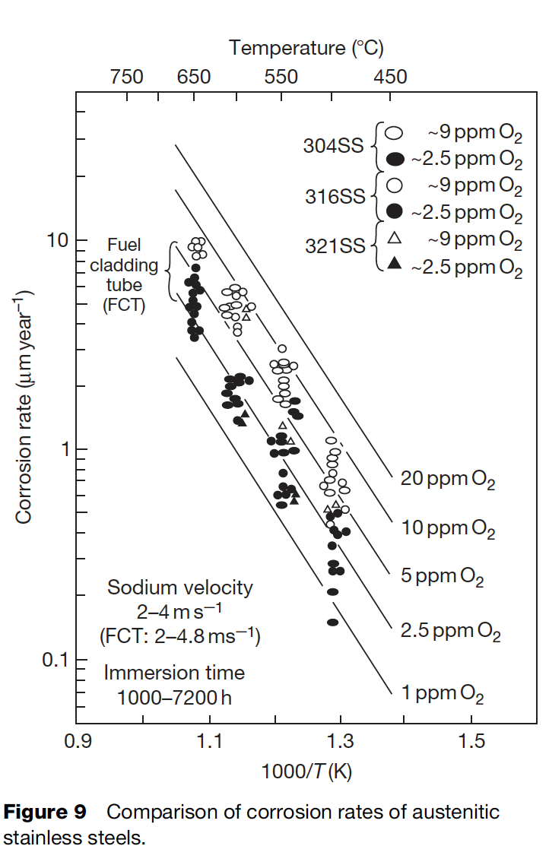
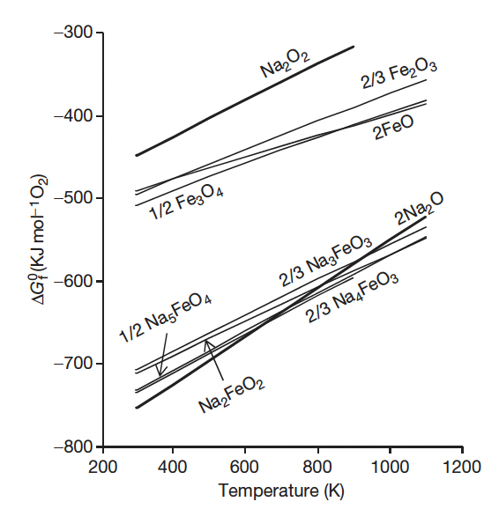


Oxygen Acceleration
The introduction of oxygen into sodium may occur during refueling, supplementing of the reactor cover gas, opening of the coolant boundary for maintenance operations, etc.
The thermodynamically stable oxide in sodium is sodium oxide, Na2O
Fe spontaneously reacts with Na2O above 380C, forming Na4FeO3
These reactions increase the effective solubility of Cr/Fe in Na

Slide 9
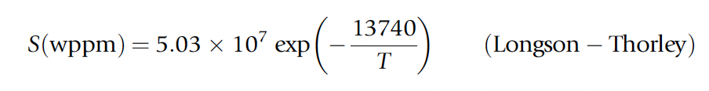
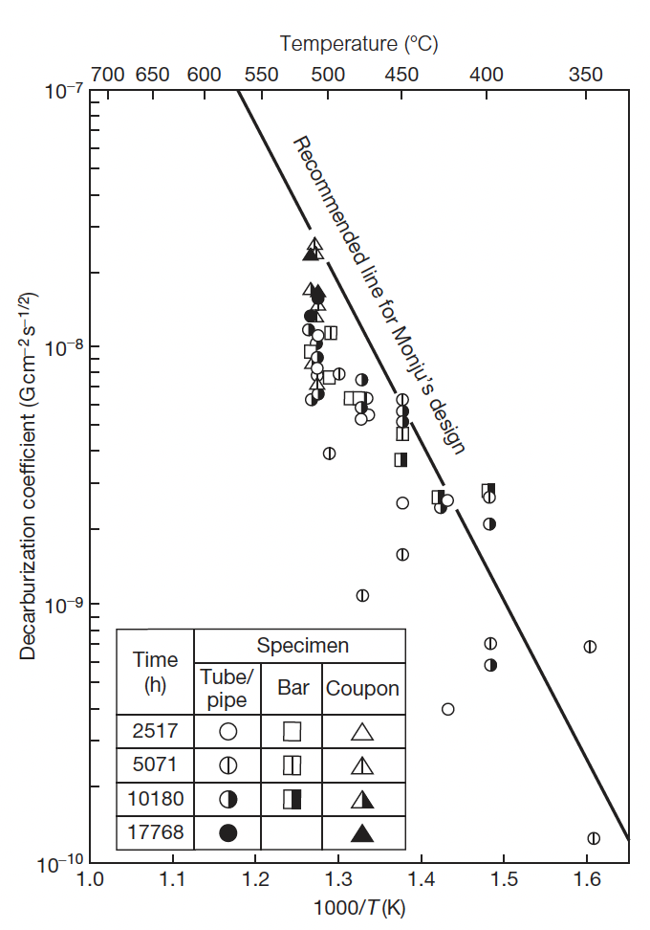
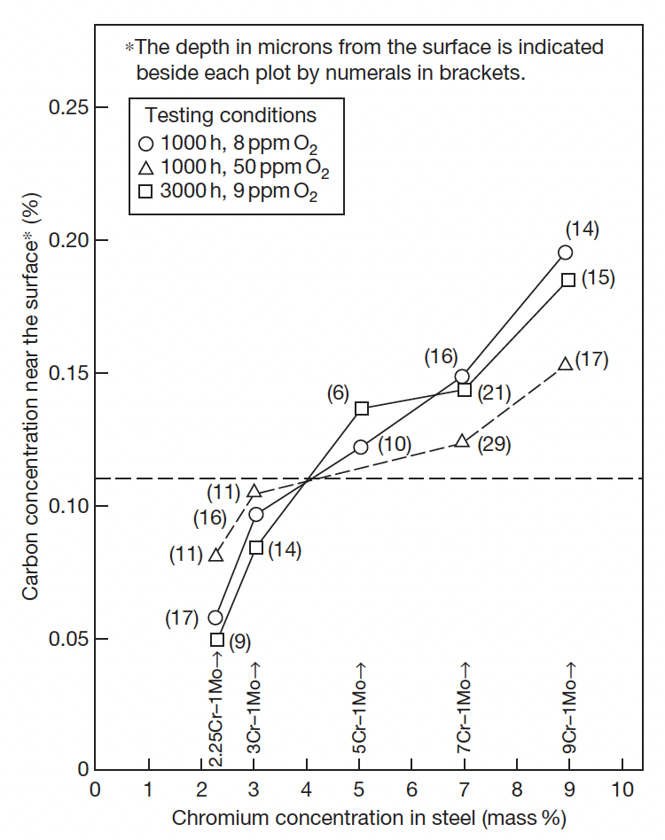

Carbon Effects
Carbon is an important element in maintaining the superior mechanical strength of steel
Carbon transfer can occur due to the chemical activity difference resulting from the temperature gradient
The materials located in the high temperature regions tend to decarburize
If a system has both austenitic and ferritic steels, carbon transfer can occur due to different chemical activities in these materials; austenitic steels carburize
High Cr content reduces susceptibility for decarburization, largely through forming Cr-C precipitates

Slide 10
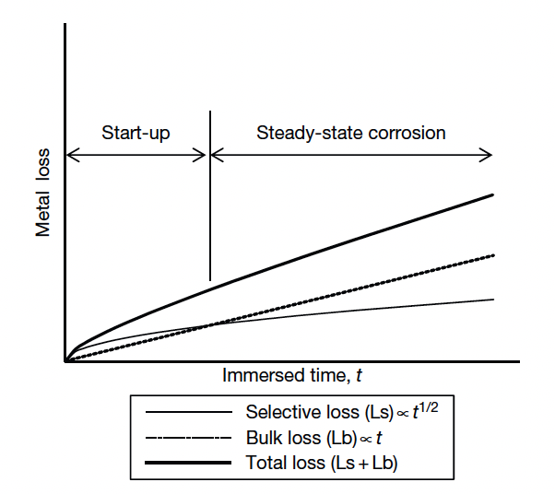
Na Corrosion of Austenitic Steel
The important factors which influence the corrosion of the steels in sodium are: (1) immersion time, (2) temperature, (3) dissolved oxygen, (4) sodium velocity, (5) alloy elements, and (6) carburization and decarburization
Ni and Mn have high Na solubilities and dissolve first in selective (start-up) corrosion, whereas Fe corrodes in general (steady-state) corrosion
Transition from startup to steady state is ~2000 h, but system specific

Slide 11
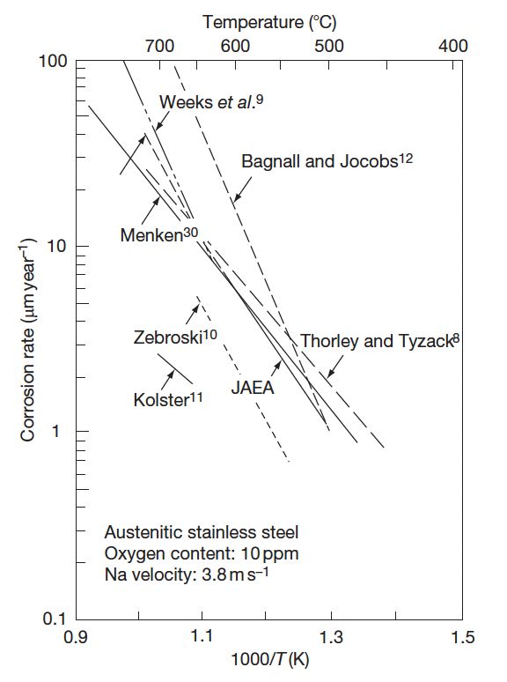
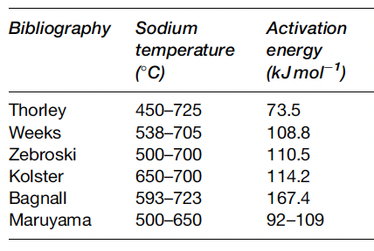
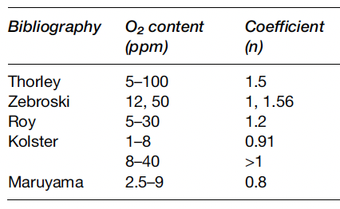
Na Corrosion of Austenitic Steel
Corrosion rate follows an Arrhenius function
The effective activation energy is a function of temperature, and agrees with the activation energy of solubility in Na
This matches the understanding of corrosion through dissolution processes
The corrosion rate is proportional to the oxygen concentration to a power n~1
Thus, limiting O2 in the Na can limit corrosion
Corrosion rates increase with velocity up to a certain point, then become velocity-independent; this is related to the boundary layer thickness at the surface in contact with flowing sodium

Slide 12
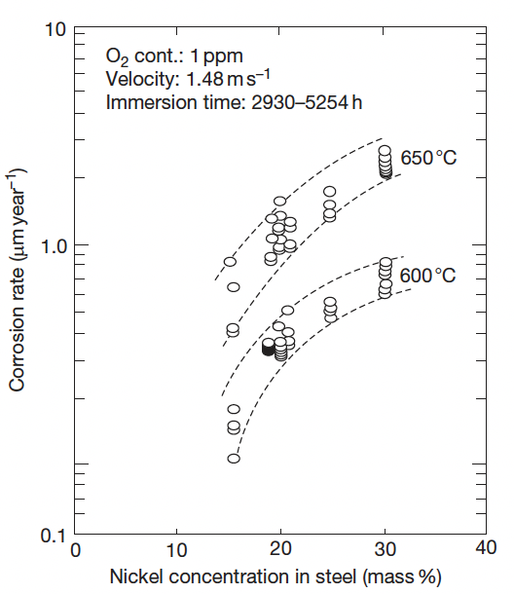
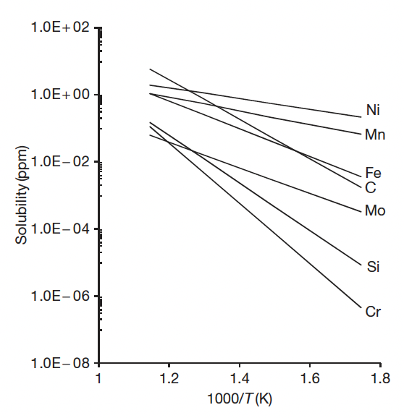
Na Corrosion in Austenitic Steel
Because this is a dissolution driven process, the alloying elements are key to corrosion rates
Ni is especially soluble in Na, and as Ni content increases, corrosion rates increase
Cr has a much low solubility in Na and is thus preferred as an alloying element for Na-facing components
Decarburization of steels can also occur due to the temperature-dependent solubility of C in Na

Slide 13
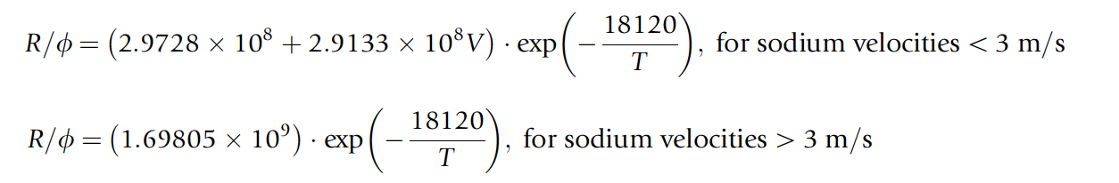
Na Corrosion in Austenitic Steel
Corrosion behavior of austenitic stainless steels is well understood over the temperature range of 455–755 C
It is known that after the initial period of exposure, steady-state corrosion is reached, which governs the long-term corrosion behavior
Have relationships for corrosion which include flow velocity, oxygen content, and temperature

Slide 14
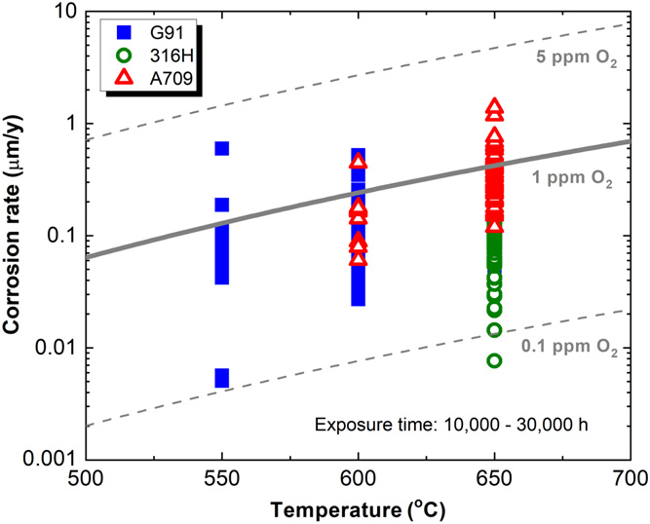
Na Corrosion in Ferritic Steels
Also sensitive to temperature, oxygen content, and Na flow velocity
Low-Cr steels show weight loss and decarburization, while high-Cr steels show weight gain and carburization
Oxygen content tends to increase corrosion rates
Flow velocity effects taper above 7 m/s, higher than in austenitic steels
In general, effects of corrosion in F/M steels are similar to austenitic steels, but with different chemical components

Slide 15
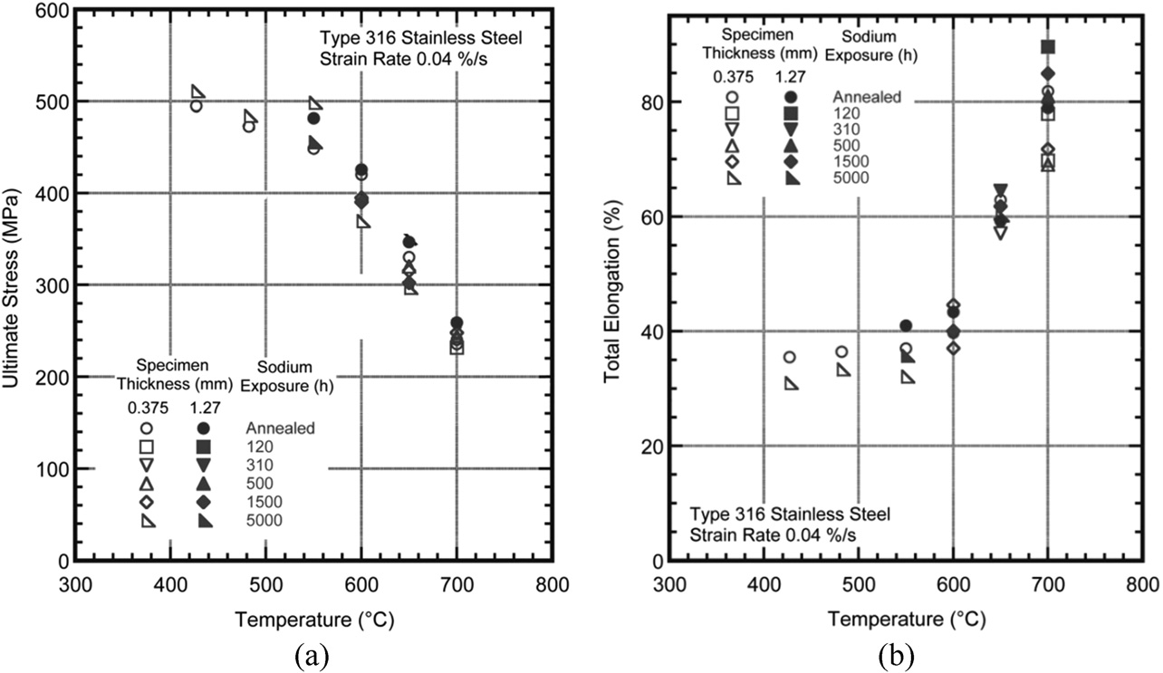
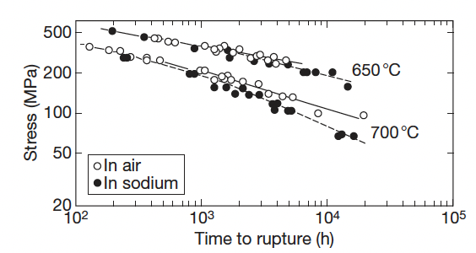
Effects on Mechanical Properties
The effect of sodium on the mechanical strength of steel is determined by three factors: (a) corrosion and mass transfer, (b) decarburization and carburization, and (c) oxidation/reduction
Since the cladding tubes are thin components and are exposed to high temperatures, the sodium corrosion effect on cladding is larger than that of the other structural materials
Minor impacts on tensile strength, elongation, and creep strength for Na vs air
Slight improvement in creep fatigue in sodium compared to air
Creep Strength

Slide 16
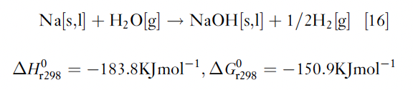
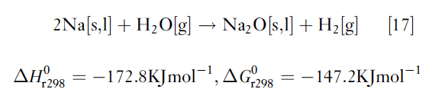
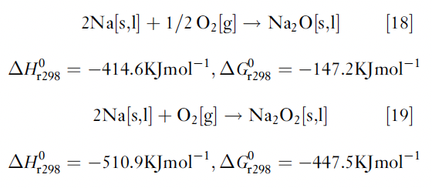
Na-Water/Air Reactions
One of the weak points of the present SFRs is the steam generator
If the steam generator tube is damaged, high-temperature pressurized steam is blown into the sodium
The environment around the failed tube is heated to high temperature (potentially up to 1200C) due to exothermic reactions
When high-temperature sodium is leaked into the atmosphere, it reacts with oxygen, and sodium oxides are formed

Slide 17
Summary
Na is used as a coolant due to high thermal conductivity, high heat capacity, high margin to boiling
There are two known mechanisms of sodium corrosion: Type I: corrosion produced by the dissolution of alloy elements to sodium; Type II: corrosion produced through chemical reaction with the impurities in sodium
Temperature gradient mass transfer is of high concern, based upon solubilities of steel elements, and highly impacts Ni
(De)carburization can occur, but can be limited with high Cr content
Oxygen accelerates corrosion by increasing effective solubilities
Sodium modified the microstructure of steels through precipitation, coarsening, etc.
Mechanical properties are minimally impacted by Na exposure

Slide 18
End of Module 2
Exam on next Thursday (10/1)
Covers SFRs

